Slide 1
Partner with AgriWings Drone Spray Services
AgriWings understand the importance of strong partnerships in providing comprehensive and efficient services to our customers.
This policy outlines the guidelines and expectations for our booking partners, ensuring a mutually beneficial and professional relationship.

Slide 2
Register as Commercial Shop Owner(CSO)
Benefits being booking partners:
Increased Customer Base
Expanded Market Reach
Marketing and Promotion
Token of gratitude:
AgriWings’s Welcome Kit includes Water bottle, Pad & Pen, Tshirt and Sweets box
CSO will be provided with copies of NOC
Banner for Marketing must be placed in the shop of CSO
Tech enabled:
Manage Your own account with AgriWings software
Training of Portal will be provided by AgriWing’s Team
User Manual for software will be provided on your mail

Slide 3
Criterion for Commercial Shop Owner(CSO) Onboarding
CSO must full fill requirements of minimum 500 retail farmers
As a retailer, Agro-Input turnover of INR 2 Crores
Excited about new agricultural technology

Slide 4
Communications with Commercial Shop Owner(CSO)
Incentives:
Partner with AgriWings as a CSO and unlock a world of benefits, including a lucrative incentives. Incentive policy communication will be shared on your registered mail ID regularly by AgriWings.
Discounts:
Join us as a CSO with AgriWings and enjoy exclusive discounts and monthly updates delivered straight to your inbox via registered mail.
Pricing:
Experience the power of personalized crop-wise service pricing and stay informed with timely communications delivered to your mailbox/Portal Login through registered mail with AgriWings.

Slide 5
Terms & Conditions
CSO must ensure that chemical readily available with the farmer at the time of AgriWings Drone spray to avail maximum incentive benefits.
We will not be able to spray near high tension wire, so CSO must confirm from the farmer to avoid disputes at the time of AgriWings Spray
To avoid disputes famer must sign NOC.
No Credit facility is available for AgriWings Drone Spray services, only Cash and Advance payments.
We will be considering land measurement which will be given by satellite. The amount to be paid will be calculated based on satellite measurement.

Slide 6
AgriWings Portal
Welcome to AgriWings business! As a valued partner, you'll have access to our online platform for efficient and environmentally friendly drone spray service. Let's collaborate and unlock new opportunities!
Manage your Online account: https://app.agriwings.in/

Slide 7
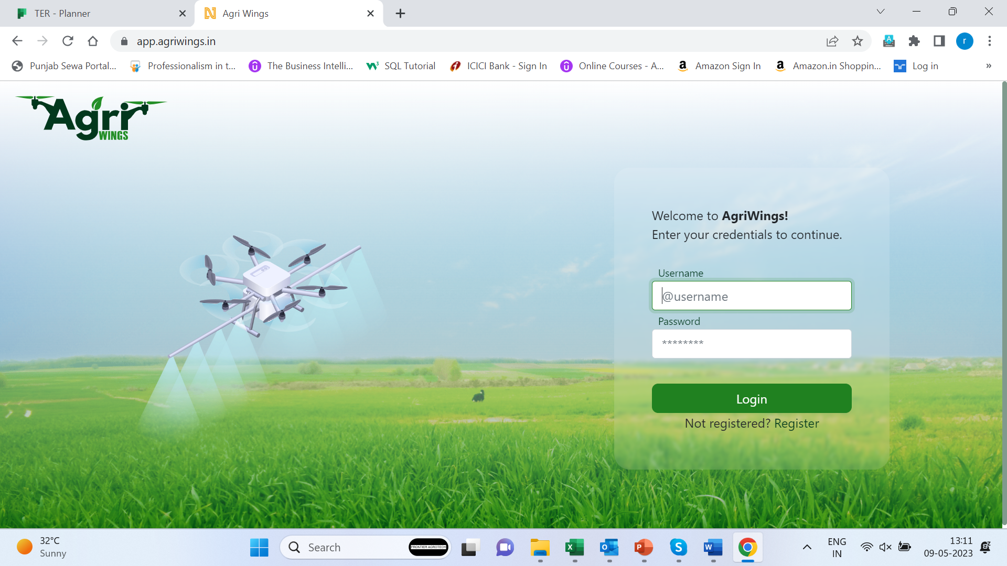
Register as Booking Partner
For Registered Booking partner:
Enter Username
Enter Password
Click Login button
First time User-Click Here

Slide 8
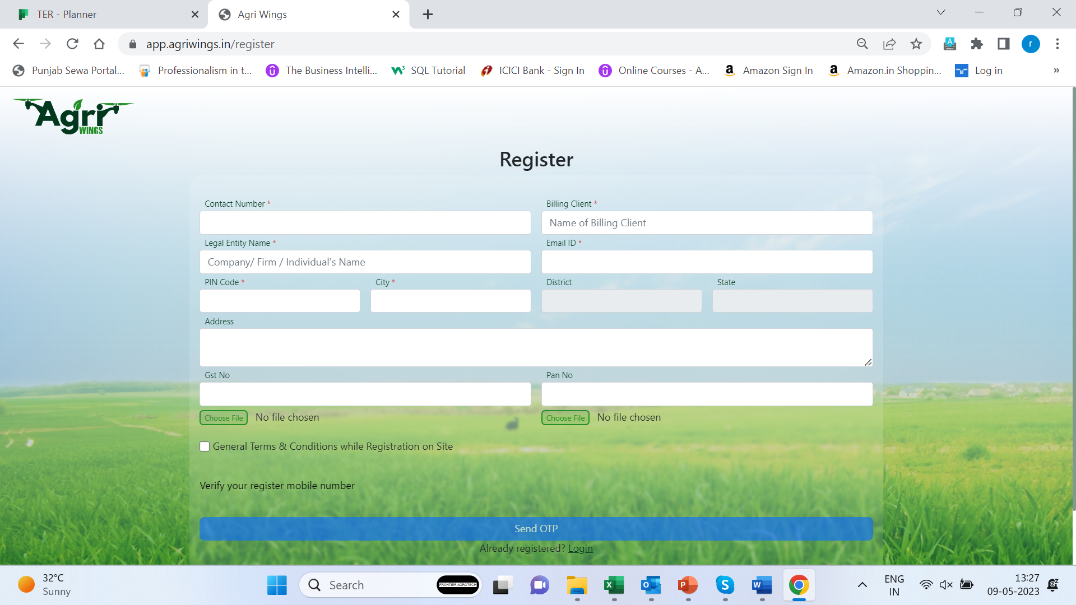
Register as Booking Partner
For First time User:
Enter Contact Number
Enter Your Name
Enter Your Firm Name
Email ID
Correct Pin code
City
Complete address of Firm
Enter GSTIN number if any
Enter Pan number if any
Check on general term & conditions
For verification of your mobile no. click on Send OTP button
Enter OTP shared on your register mail id

Slide 9
Register as Booking Partner
OTP Verified
Your AgriWings credentials are shared on your registered mail

Slide 10
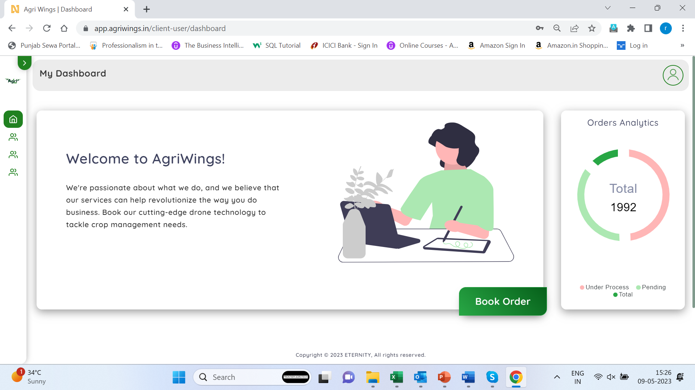
Book Order
Booking Your Order

Slide 11
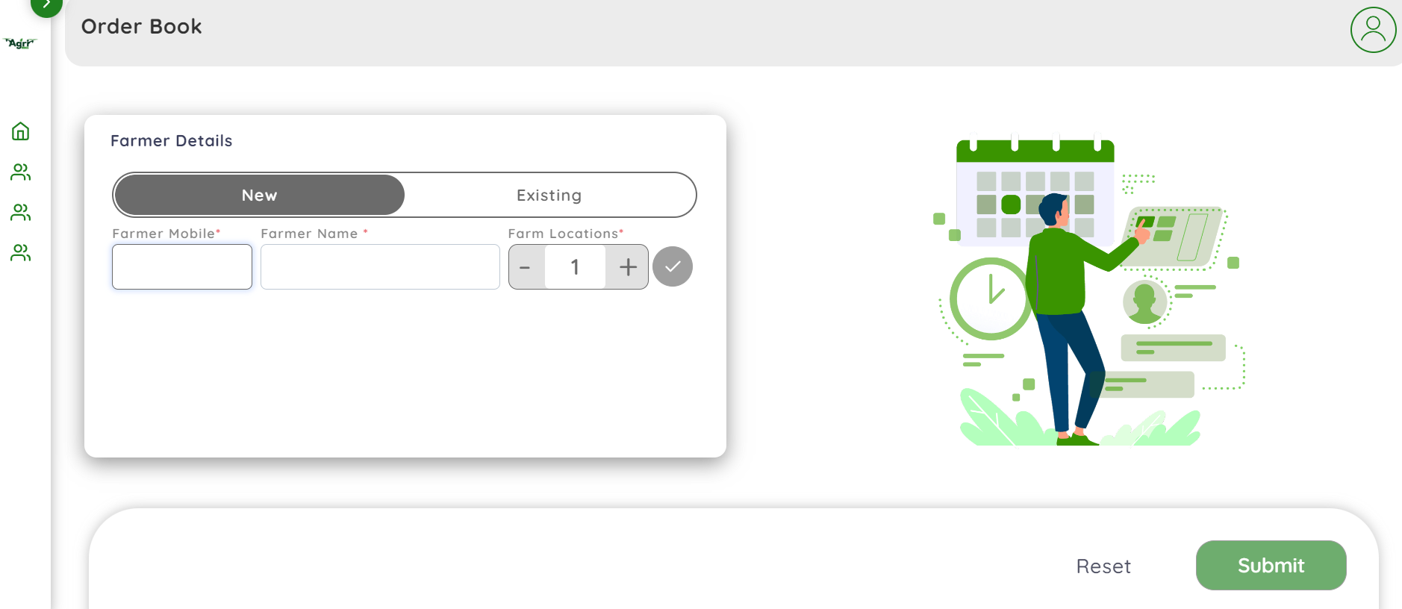
New Farmer Detail
Add new farmer:
Enter mobile No. of farmer
Enter name of farmer
Select number of locations for spray

Slide 12
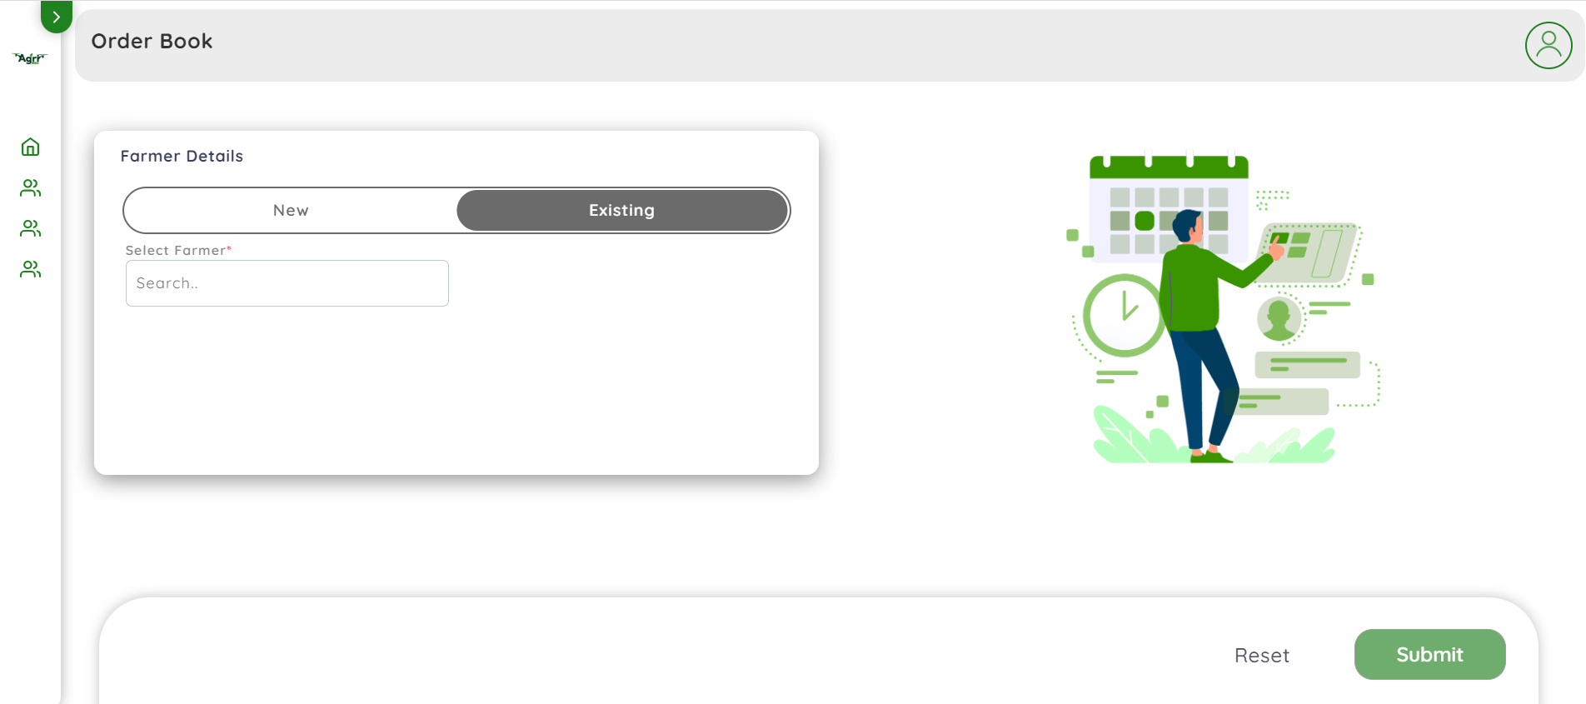
Existing Farmer Detail
Select Existing Farmer from the list

Slide 13
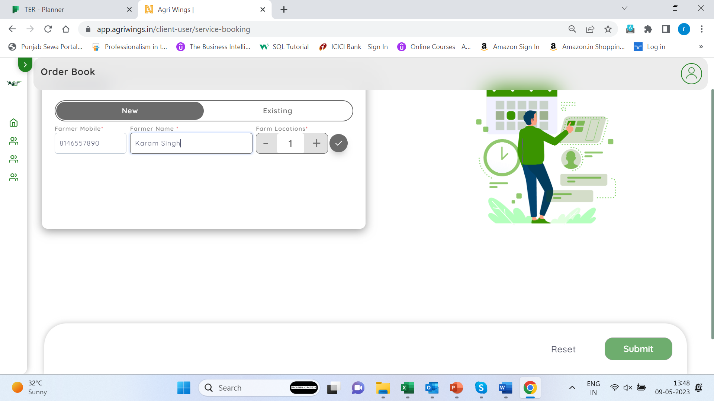
Enter detail of Farmer & Farm
Click here

Slide 14
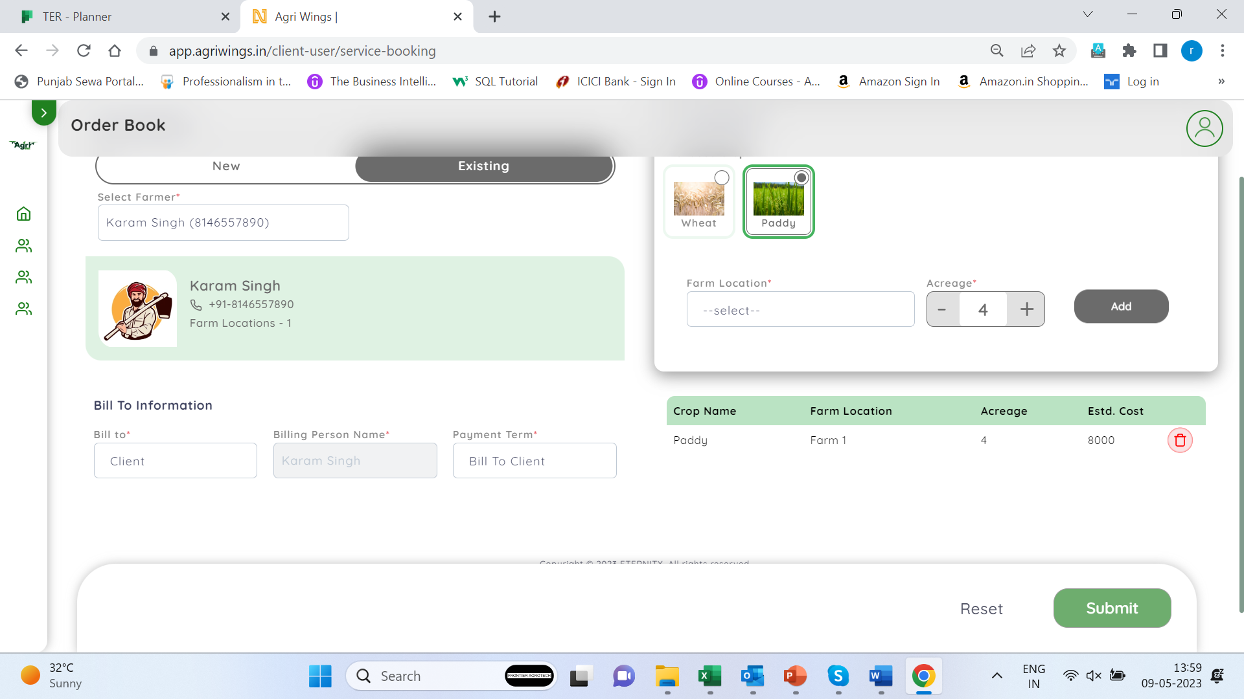
Enter Order Detail
Step2- Select Farm Location & Acreage
Step3-Press Submit
Step1-Select Bill to Information

Slide 15
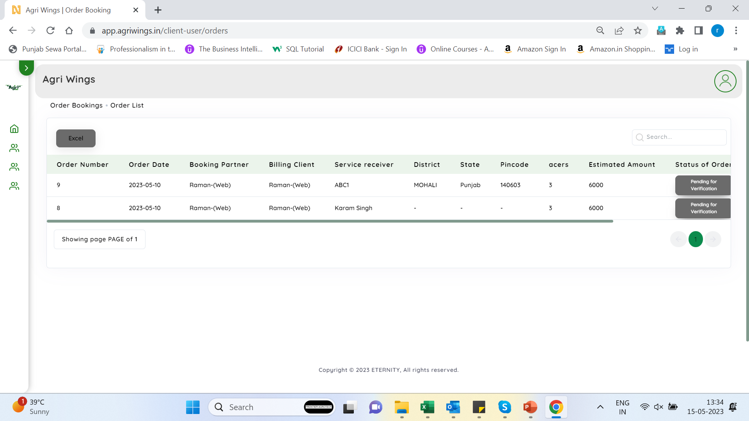
List of Unverified orders
Click here for to see list of unverified orders list

Slide 16
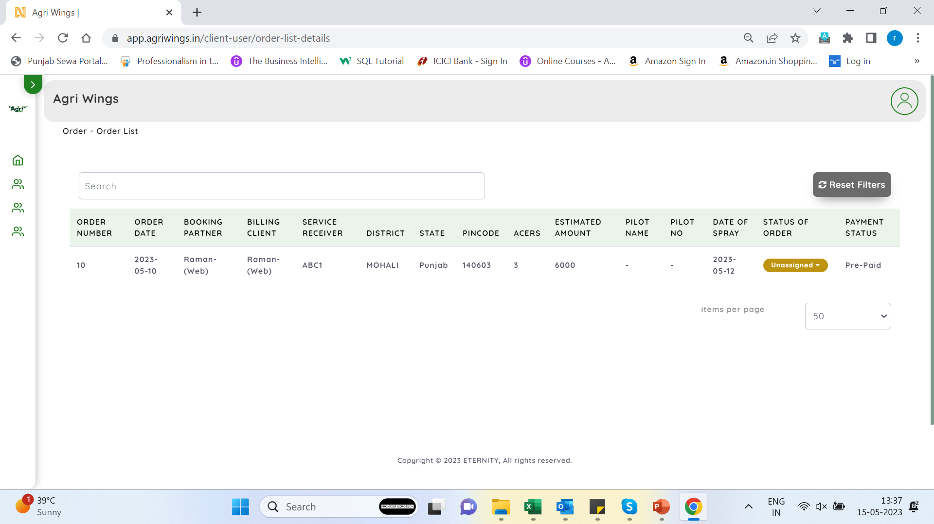
Verified Order List
Click here for to see list of verified order list

Slide 17
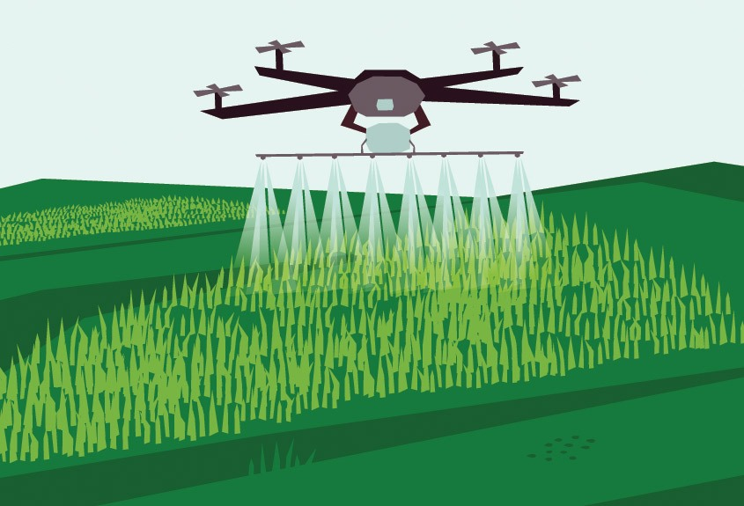
Thank You & Welcome to the world of AgriWings

